Slide 1
PowerShell Scripting Transformed The Impact of ChatGPT & AI
Presented by
Doug Finke

Slide 2
Catch up with me
X : @dfinke - https://x.com/dfinke
GitHub: https://github.com/dfinke/PowerShellAIAssistant
YouTube: https://www.youtube.com/@DougFinke
Blog: https://dfinke.github.io/

Slide 3
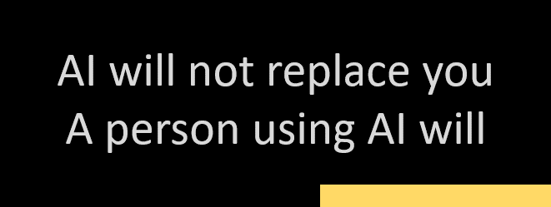
Embrace the Power
AI is an emerging skill

Slide 4
Imagine a highly capable assistant or smart intern
Always-On Assistant, Efficient and Accurate Helper:
Available 24/7
Can generate scripts, offer suggestions, and help with problem-solving at any time, without breaks or downtime
ChatGPT learns quickly, reducing errors and enhancing script quality
AI - Making humans scalable
Handle Large Volumes of Work
Integration Benefits: GPT integration increases scripting efficiency and scalability
Free Up Human Talent

Slide 5
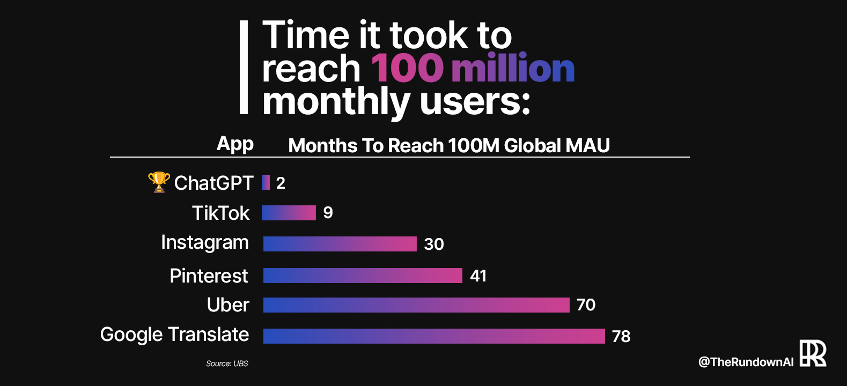

Slide 6
Play along
Get the module now: Install-Module PowerShellAIAssistant
Simple instructions to get an OpenAI Key
On github, docs and “How to” videos
https://github.com/dfinke/PowerShellAIAssistant

Slide 7
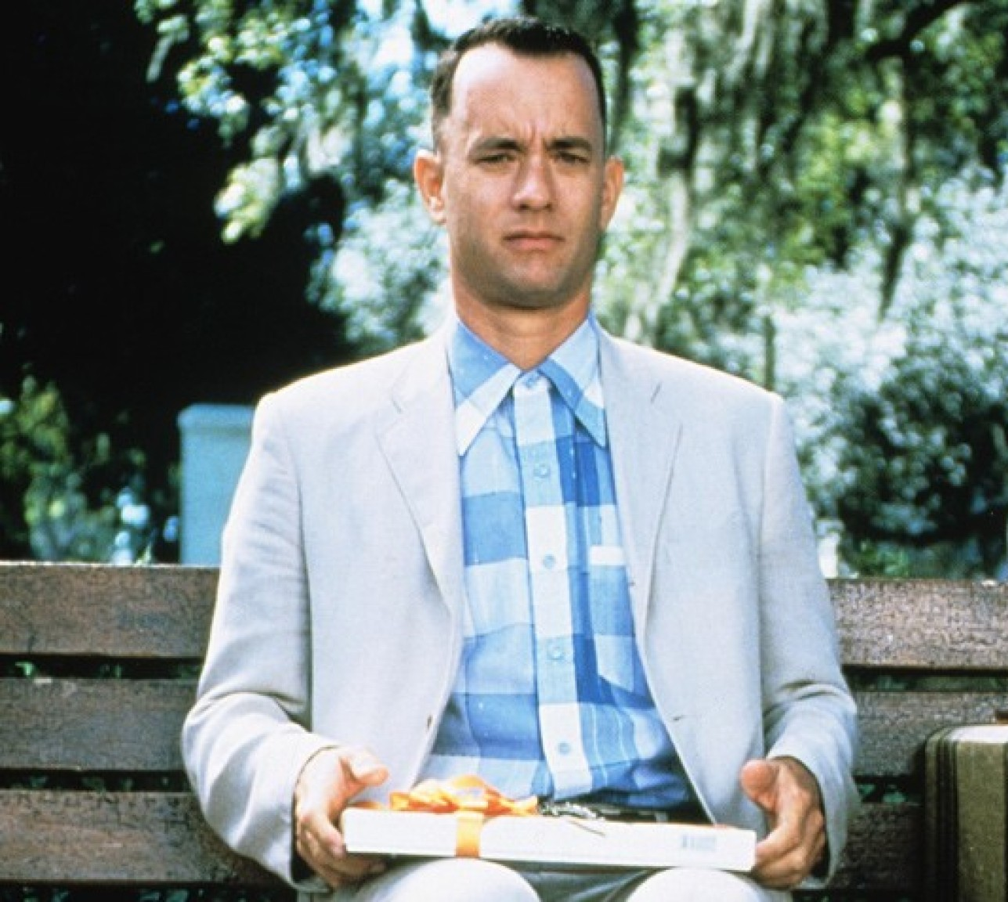
To Sum it up
ChatGPT is like a box of chocolates
You never know what you're gonna get
ChatGPT hallucinates and confabulates!
You are responsible for what you use in production with this tool

Slide 8
Topics for the AIware conference
How would future software look like in the FM era?
How to integrate legacy software in future AIware?
Do existing programming models (e.g., object-oriented or functional programming) and SE practices (e.g., test-driven development and agile) remain suitable for developing and maintaining software in the FM era?
What roles do autonomous agents play in the development and maintenance of software in the FM era?
How will inner and open source collaboration evolve in the FM era?
What are the implications and effectiveness of foundation models in improving software engineering practices and outcomes?
How does AIware impact developer productivity?
What kind of release engineering practices do we need for FM-powered software applications? Are LLMOps comprehensive enough to capture the release engineering needs of AIware in the FM era?
How do we debug and monitor AIware in the FM era?
How should we change SE curriculum, training and mentoring in the FM era?
How to evolve FMs from the perspective of AIware and its makers in the FM era?
How do human interactions and perceptions shape the development and implementation of AIware in the FM era?
How do we measure and improve the trustworthiness of AIware in the FM era?

Slide 9
Catch up with Doug
X : @dfinke - https://x.com/dfinke
GitHub: https://github.com/dfinke/PowerShellAIAssistant
YouTube: https://www.youtube.com/@DougFinke
Blog: https://dfinke.github.io/

Slide 10
Demo

